Slide 1

ME 535 Computer-Aided Geometric Design Final Project Yifan Liang 12-10-2014

Slide 2
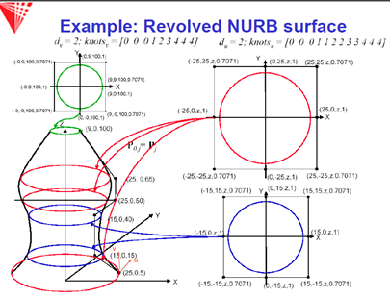
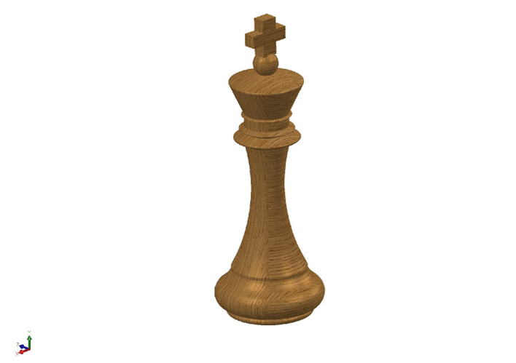
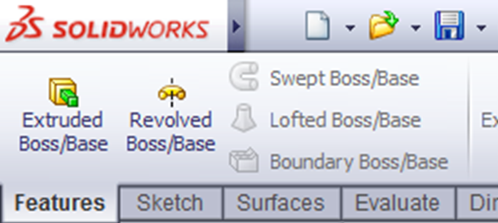
Initial Idea
NURB surface-Revolve
SolidWorks-Revolve
Notes:
-Inspired
-CAD
-chess king

Slide 3

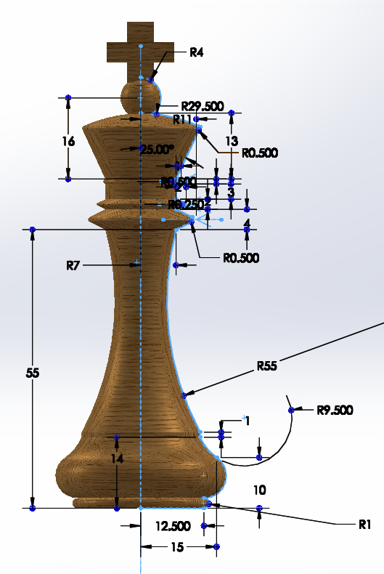
Technical details-1
Notes:
-two parts: cross section & revolving base
-NURB surface: set u and v

Slide 4
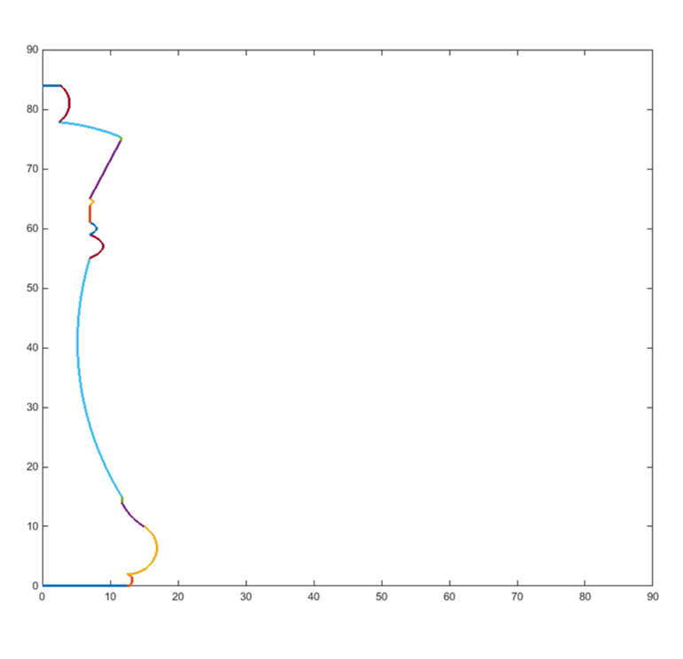
Technical details-2
Curves along v-direction: 4 Bezier and 11 B-spline curves
Notes:
-v composition and construction
-u easier

Slide 5
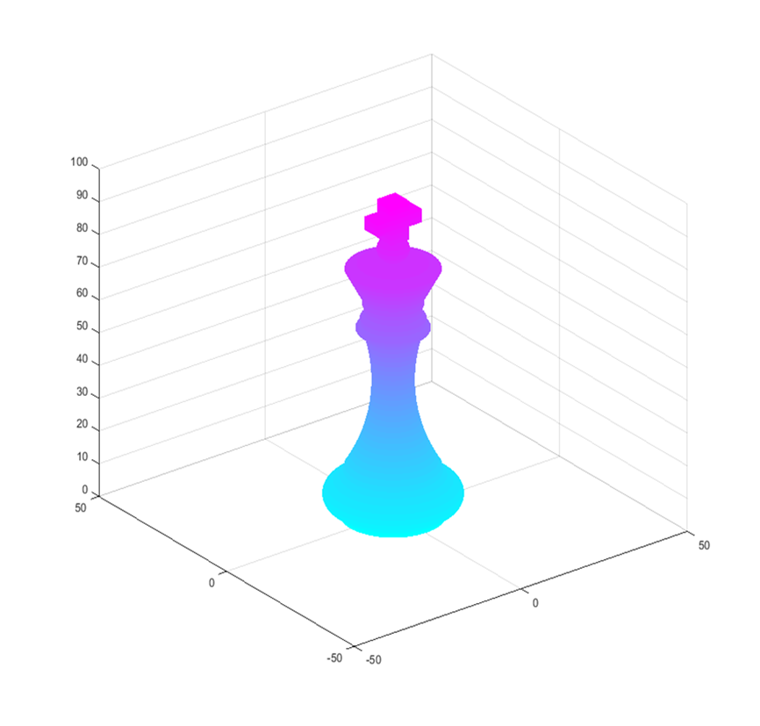
Technical details-3

Slide 6
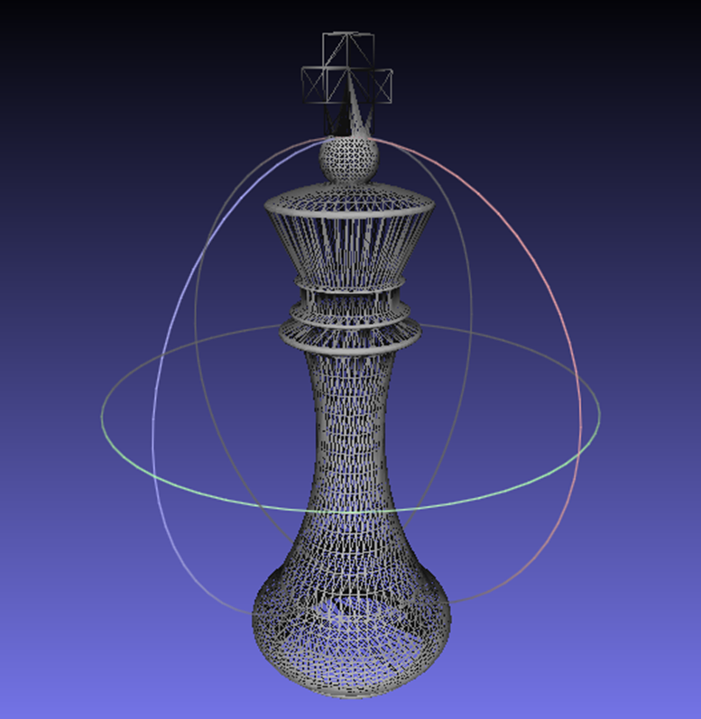
Technical details-4
STL view in Meshlab
Notes:
-surf2stl Matlab function
-Meshlab checking, fixed the surface normal

Slide 7
Thanks!

